Slide 1


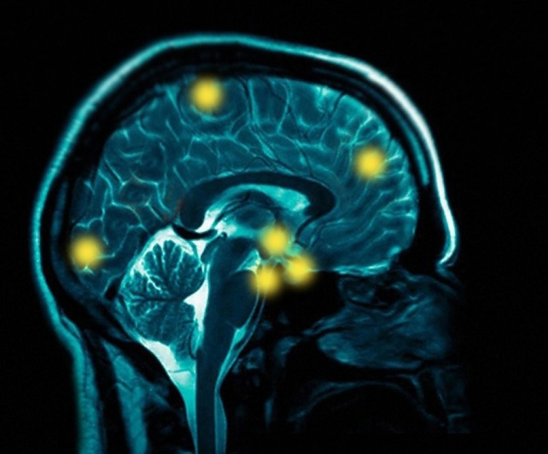

NIH SBIR/STTR In Your Portfolio
Health TechNet, McLean, VA
February 15, 2013
National Institutes of Health
Lenka Fedorkova, Ph.D.
Assistant Manager
SBIR/STTR Programs
Office of Extramural Research, NIH

Slide 2








NIH Mission
Improve human health through biomedical and behavioral research, research training and communications.

Slide 3
SBIR Purpose and Goals
Stimulate technological innovation
Use small business to meet Federal R&D needs
Foster and encourage participation by minorities and disadvantaged persons in technological innovation
Increase private-sector commercialization innovations derived from Federal R&D
Small Business Innovation Development Act of 1982

Slide 4
STTR Purpose and Goals
Stimulate and foster technological innovation through cooperative research and development carried out between small business concerns and research institutions
Foster technology transfer between small business concerns and research institutions
Small Business Research and Development Enhancement Act of 1992

Slide 5
Case by Case Waivers
Performance of the R&D work for Phase I and Phase II must be performed in the United States.
In rare and unique circumstance, for example, if a supply or material or the study design (e.g., patient population) is not available in the United States, NIH may allow that particular portion of the research or R&D work to be performed or obtained in a foreign country.
Situations will be considered on a case-by-case basis, and they should be discussed with NIH staff prior to submission of the application.

Slide 6

The largest, most accessible source of
SEED CAPITAL for the nation’s innovative small businesses
$2.5 Billion in 2013
SBIR/STTR Programs

Slide 7

SBIR/STTR Programs
Capital is in the form of grants and contracts
Strategic NIH Investment in Innovation
Non-diluted funding:
no repayment
no debt service
no equity forfeiture
no IP forfeiture
Notes:
NIH provides early-stage, seed capital to support innovation and commercialization upon which small businesses can build a sustainable future.
The SBIR/STTR set-aside is the largest accessible source of non-dilutive capital US small businesses can tap into with no strings attached.
The total Federal investment in small businesses in FY 2010 was about $2.3 billion .
[Read bullets]

Slide 8
SBIR/STTR Program Overview
SMALL BUSINESS INNOVATION
RESEARCH (SBIR) PROGRAM
Set-aside program for small business concerns to engage in Federal R&D -- with potential for commercialization. (Agencies > $100M extramural R&D)
SMALL BUSINESS TECHNOLOGY
TRANSFER (STTR) PROGRAM
Set-aside program to facilitate cooperative R&D between small business concerns and U.S. research institutions -- with potential for commercialization.
(Agencies > $1B extramural R&D)
2.6%
0.35%

Slide 9
SBIR Eligibility Criteria
From 1/28/2013 FOAs going forward
Organized as for-profit U.S. business
Small: 500 or fewer employees, including affiliates
PD/PI’s primary employment must be with small business concern at time of award and for duration of project period
Greater than 50% U.S.- owned by individuals and independently operated or
Greater than 50% owned and controlled by other business concern/s that is/are greater than 50% owned and controlled by one or more individuals OR
Be a concern which is more than 50% owned by multiple venture capital operating companies, hedge funds, private equity firms, or any combination of these

Slide 10
STTR Eligibility Criteria
Applicant is Small Business Concern
Formal Cooperative R&D Effort
    Minimum 40% by small business
    Minimum 30% by U.S. research institution
U.S. Research Institution
    College or University; other non-profit research organization; Federal R&D center
Intellectual Property Agreement
    Allocation of Rights in IP and Rights to Carry out
    Follow-on R&D and Commercialization

Slide 11
PD/PI Eligibility on STTR
PD/PI is not required to be employed by SBC
PD/PI at RI must establish contract between RI and SBC describing PD/PI’s involvement
PD/PI must commit a minimum of 10% effort
PD/PI’s “signature” on application is agreement to conforming to Solicitation requirements
SBIR/STTR Program Overview

Slide 12
Agency Differences
Contracting Agencies
  Agency establishes plans, protocols, requirements
  Highly focused topics
  Procurement mechanism
  for DOD and NASA
  More fiscal requirements
Granting Agencies
  Investigator initiates
  approach
  Less-specified topics
  Assistance mechanism
  More flexibility
DOD HHS/NIH
NASA ED
EPA DOT
DOC DHS
HHS/NIH NSF
ED USDA
DOE

Slide 13




















Organizational Structure of NIH
Office of Research
Infrastructure Programs
Office of the Director
http://www.nih.gov/icd
National Institute
on Aging
National Institute
on Alcohol Abuse
and Alcoholism
National Institute
of Allergy and
Infectious Diseases
National Institute
of Arthritis and
Musculoskeletal
and Skin Diseases
National Cancer
Institute
National Institute
of Child Health
and Human
Development
National Institute on
Deafness and Other
Communication
Disorders
National Institute
of Dental and
Craniofacial
Research
National Institute
of Diabetes and
Digestive and
Kidney Diseases
National Institute
on Drug Abuse
Mission to catalyze the generation of innovative methods and technologies that will enhance the development, testing, and implementation of diagnostics and therapeutics across a wide range of human diseases and conditions.
National Institute
of Environmental
Health Sciences
National Eye
Institute
National Institute
of General
Medical Sciences
National Heart,
Lung, and Blood
Institute
National Human
Genome Research
Institute
National Institute
of Mental Health
National Institute
of Neurological
Disorders and
Stroke
National Institute
of Nursing Research
National Institute
on Minority Health
and Health
Disparities
National Center
for Complementary
and Alternative
Medicine
Fogarty
International
Center
National Center
for Advancing
Translational Sciences
National Library
of Medicine
National Institute
of Biomedical
Imaging
and
Bioengineering
NIH Clinical Center
Center for
Information
Technology
Center for
Scientific Review
No funding
authority

Slide 14

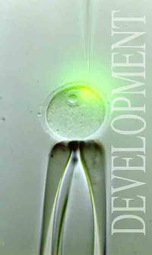

NIH SBIR/STTR: 3-Phase Program
PHASE I (Feasibility Study)
  $150K SBIR guideline; 6 months
  $150K STTR guidelines; 12 months
PHASE II (Full Research/R&D)
  $1M SBIR & STTR guideline and 2 years +
PHASE IIB (Competing Renewal/R&D)
  Clinical R&D; Complex Instrumentation/Tools
  $1M/year; over 3 years
PHASE III (Commercialization Stage)
  Non-SBIR/STTR funds; NIH rarely customer
  Consider partnering and exit strategy early –leverage $$

Slide 15
NIH SBIR/STTR Budget Allocations FY2012

Slide 16
Which Program is Best for You?
Major Differences
Research Partner
SBIR: Permits partnering as needed
(min 33% Ph I; 50% Ph II)
STTR: Requires partnering with Research Institution
(SBC min 40%; RI min 30%)
Principal Investigator
SBIR: Primary employment must be with small business concern
STTR: PI may be employed by research institution or small business concern
STTR: PI must commit minimum 10% effort
U.S. Small Business Concern is ALWAYS
Applicant/Awardee Organization

Slide 17
Mission-Focused NIH Funding Model
A Two-Way Approach:
NIH uses Omnibus Grant Solicitation - investigators propose ideas –Parent Funding Announcements (FOAs) for SBIR/STTR
NIH uses Contract Solicitation- investigators respond to defined topics
SBIR/STTR – primarily investigator initiated
5% are contracts – NIH not the ‘customer’

Slide 18
SBIR/STTR:
Important Facts to Remember
Eligibility is determined at time of award
PD/PI is not required to have a Ph.D./M.D.
PD/PI is required to have expertise to oversee
project scientifically and technically
Applications may be submitted to different
agencies for similar work
Awards may not be accepted from different
agencies for duplicative projects
SBIR/STTR Program Overview

Slide 19
Solicitations and Due Dates
Annual SBIR/STTR Omnibus Grant Solicitation
“Parent FOAs” SBIR: PA-13-088 STTR: PA-13-089
Release: January
Standard Due Dates: April 5, Aug 5, Dec 5
(AIDS/AIDS-related: May 7, Sept 7, Jan 7)
NIH Guide for Grants and Contracts
Release: Weekly Receipt dates specified in each Targeted FOA – various due dates, review criteria, duration!
http://grants.nih.gov/grants/guide/index.html
SBIR Contract Solicitation (NIH, CDC)
Release: August November receipt date

Slide 20
Limited Award Waiver from SBA
NIH has received a limited waiver from SBA, as authorized by the statute, to exceed the hard cap for specific topics that can be found here.
Due to the nature of the waiver, some NIH Institutes and Centers generally will not consider applications with budgets over $225,000 for Phase I and $1,500,000 for Phase II.
Applicants are strongly encouraged to contact NIH program officials prior to submitting any application in excess of the hard cap ($225,000 for Phase I and $1,500,000 for Phase II).

Slide 21
Important changes in this year’s Omnibus Grant Solicitations
Technical Assistance option
  NIH offers distinct technical assistance programs to SBIR Phase I and Phase II awardees (Niche & CAP)
  Applicants wishing to utilize their own technical assistance vendor are required to include this in your budget and provide a detailed budget justification.
  Please note, if funds are requested to utilize your own technical assistance vendor and an award is made, the awardee is not eligible to apply for the NIH-provided technical assistance program for the phase of their award.

Slide 22
New provisions NOT implemented in this year’s Omnibus Grant Solicitations at this time
1. No Switching mechanisms at Phase II
  Applicants cannot apply for Phase II SBIR funding based on a Phase I STTR award or conversely a Phase II STTR based on a Phase I SBIR award. Similarly, applicants cannot apply for a Phase IIB SBIR or STTR based on a Phase II STTR or SBIR award, respectively.
  No Direct Phase II applications (pilot FOAs when implemented)
  Why not? NIH is currently updating its electronic systems and forms for these provisions.

Slide 23
New provisions NOT implemented in this year’s Omnibus Grant Solicitations at this time
3. VC-backed companies (VCOC, Hedge fund, private equity firm) CANNOT apply at this time.
  SBA Company registry at SBIR.gov.
  Why not? SBA’s new eligibility rules went into effect after NIH issued the Omnibus solicitations. NIH is currently updating its electronic systems and forms for these provisions.

Slide 24
If not now, when?
NIH intends to revise, amend or re-issue the Omnibus solicitations in the middle of 2013 to implement additional reauthorization provisions as guidance from the SBA is received and electronic system and form updates at NIH and SBA are implemented.

Slide 25
SBIR/STTR Program Descriptions and Research Topics
Your Ideas: Suggested topic areas*
Biodefense
Biosensors
Nanotechnologies
Bioinformatics
Diagnostic and Therapeutic Devices
Telehealth
Proteomics / Genomics
Biosilicon devices
Biocompatible materials
Acousto-optics / opto-electronics
Health IT
Imaging devices
Genetically engineered proteins
Mobile applications…

Slide 26
EXAMPLE TARGETED FOA: IT Health
RFA-MH-14-010: Clinical Neuroscience and Entertainment Software Pilot Partnership Program to Develop Neuropsychiatric Interventions (R43/44)
PA-13-052/053: Technological Improvements to Data Collection in NIDDK Clinical Studies (SB/ST)
PA-11-335: Lab to marketplace: Tools for Biomedical and Behavioral Research (SB/ST)
PA-11-135: Phase IIB Grants for Brain and Behavior Tools (R43)
PA-10-149/150: Bioengineering Nanotechnology Initiative (R41/42)

Slide 27
Electronic Submission
SBIR/STTR grant applications must be submitted electronically
SBIR contract proposals still in paper form
Must be a registered SBC, i.e. DUNS, CCR#s
Registrations are required!!!
  Grants.gov (company)
  eRA Commons (company and all PD/PIs)
http://era.nih.gov/ElectronicReceipt/index.htm

Slide 28
Transitioning to Phase III
Early-Stage Capital for Innovation
Stimulating Economic Growth

Slide 29
NIH Awardee Needs
Investment = Cash Flow “Valley of Death”
Market Validation = who will buy your product or pay for your service?
Defining Your Customer – Is your technology a “needed” solution to a defined problem?
Penetrating well-established/ crowded markets = Who is your competition versus strategic partner?
Protecting Intellectual Property = your “worth”

Slide 30


Gap Funding Programs
Phase II B Competing Renewal Award
Mt. “FDA”
Phase I
Phase II
Phase III
No-Cost Extension
Phase I / Phase II Fast Track
Administrative / Competitive Supplements
“Valley of Death”
Notes:
The NIH attributes its program success to its flexible and adaptable funding model that is largely investigator-initiated. That means, companies propose ideas to us, we review them and make funding decisions.
As mentioned in the NIH overview presentation, we award project budgets that are sometimes larger than the guidelines in situations where the science and cost of business justifies that funding need.
Over the years, we have developed creative ways to close gaps between the phases through the Phase I-Phase II Fast Track Program or issue cost extensions through competitive supplement awards to see projects through to completion.
Likewise, we are very mindful of the exceptional costs involved especially in projects involving clinical trials and FDA approval. Thus, in 2003 we have developed the Phase IIB Competing Renewal Award to assist SBIR and STTR companies facing the regulatory Mount FDA or the proverbial financial Valley of Death that I will talk about in a few moments.

Slide 31

Gap Funding Opportunities
Phase I & II Fast Track
SBIR/STTR Phase I + II one-time
simultaneous submission!
Concurrent review (7-9 months)
Phase I Final Report
Milestones met = Phase II Award
Save 6-9 months
Phase IIB Competing Renewal
Takes Phase II - developed
promising compounds & devices to
next stage of medical device/ drug
refinement & development
$$$ support clinical research tools, complex instrumentation, prototype development
Maximum $1 M/ year x 3
13 Institutes & Centers accept
No Matching Funds Required!
Notes:
Let me first address the additional gap funding assistance we provide to our companies.
The Fast Track program that is available at most of our ICs to both SBIR and STTR applicants was developed to address a funding delay for companies that have already completed some preliminary studies for the proof of concept with a momentum to take on the second phase in a few months time. These companies cannot skip Phase I as dictated by law so we have devised this approach to overcome a limitation that we feel is counterproductive. Fast Track requires a one-time application that eliminates 7 to 9 months of waiting for a funding decision on a Phase II application going through peer review. Once awarded, the company completes Phase I, submits its milestones report, and if approved, Phase II funding is approved. Important note, Phase II money is not guaranteed as award is contingent on approval of phase I milestones report, but afterwards there is no need to apply again.
The Phase IIB program provides follow on gap funds to the original Phase II project.
These funds, a total of up to $3 million split over 3 years, are critical in advancing the projects involving pre-clinical studies, early efficacy or toxicity studies, scale up of medical device prototype development and the like. This additional investment greatly helps us leverage the initial investment we have made in the early-stage idea. Also, now more than ever, fill the funding gap where third party investments are truly scarce or exceptionally risk averse. As a result, our companies are more ready to approach the FDA and have increased their intrinsic value which makes them more attractive to outside investors and strategic partners. As we know the valuation of an early-stage company is its most valuable currency after a well-protected IP.
One additional point I want to make about the Phase II B investment. In order to truly bridge the gap in support for companies beyond the SBIR program, we highly encourage companies to think long-term and diversify their sources of investment whether in form of investments by venture capital firms, angel groups, foundations, or in kind and strategic support through alliances and joint ventures. Our NIH policy does not require matching funds.

Slide 32
Innovative Approaches
to Commercialization Challenges
NIH Technical Assistance Programs
Technology Niche Assessment
Mt. “FDA”
???
Commercialization Assistance Program
Phase I
Phase II
Phase III
“Valley of Death”
Notes:
Since 2004, we have been providing our SBIR awardees a suite of Technical Assistance Programs. Presently we offer the Niche Assessment Program for Phase I SBIR awardees and the Commercialization Assistance Program for Phase II SBIR awardees. Both of these serve an important complementary function to help these companies become successful in commercializing their technologies in the long run.

Slide 33

Niche Assessment Program
Phase I SBIR awardees
With current or soon to be awarded Phase I (Notice of Award)
Technology Niche Analysis ™
Report helps Phase II submissions:
Identify other uses of technology
Determines competitive advantages
Market size and potential
Barriers to entry & strategy
Feedback from potential end-users
Notes:
In the Niche Assessment program the companies receive an analysis report, called the Technology Niche Assessment or TNA, that provides a comprehensive picture of the market opportunity for their technology. This often helps companies not only with preparing a stronger Phase II application, but overall helps them think more strategically and concretely about market positioning.
In the CAP, which is a 10-month long training and mentoring program, we work through important issues and challenges the companies face ranging from developing an investor pitch, attracting strategic partners, developing a value proposition, preparing for a meeting with the FDA, developing a licensing strategy or a go-to-market strategy. Companies are pared up with a Larta adviser and industry expert resources and work together to complete clearly defined goals during the program.

Slide 34
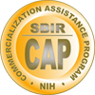

Commercialization Assistance Program (CAP)
Phase II SBIR/STTR awardees
Active or 5 years since completion of project
Personalized Business Mentoring; Knowledge Transfer; Business Outcomes!
Business & strategic planning
Investor & partnership pitch
Technology Value Proposition
FDA regulatory requirements
IP & Licensing Issues
Go-to-market strategy…

Slide 35
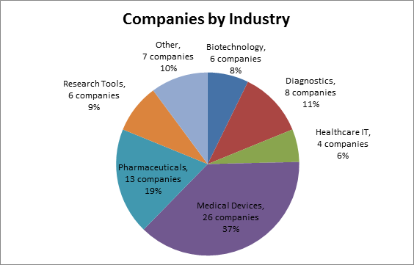
Companies in CAP 2013:
68 Total

Slide 36

Tracking Impact
  ~700 companies trained since 2004
    - Over $464 M raised in equity
    - 1,679 new jobs
    - 13 M&A
    How do we measure SUCCESS?
  Meetings or deals with investors
  FDA meetings or milestones met
  Revenues; Products launched
  Signed licensing agreements
  Hired new employees
  Established partnerships; Signed CDA
Notes:
The Assistance Programs have been around since 2004 and we are starting to develop a concrete picture of the outcomes and the impact. We always get asked: how do you measure success?
[Read bullets]
Keep in mind we track companies for 18 months so with about 5 years of complete tracking data in, we are able to make some assertions with hard evidence. We still have the last two years of CAP in tracking so I am not including those in my remarks…
By the numbers:
We have to date trained close to 700 SBIR companies.
Collectively raised almost $400 million in equity
We have had 10 acquisitions (8 companies and 2 technologies)
Bottom line: National Academies has conducted an assessment of our programs and found that between 40 and 50% of our companies commercialize. That is a very high success rate and we’d like to think that our Assistance Programs are contributing in a major way.

Slide 37
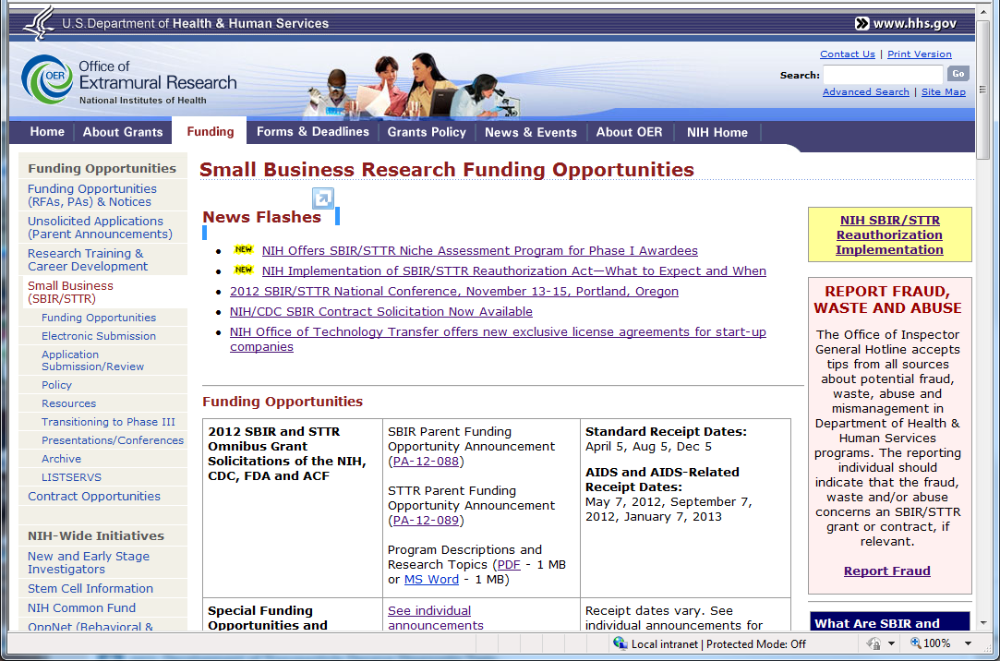
NIH Website and Reauthorization pages
http://sbir.nih.gov
Standard Due Dates:
Apr 5; Aug 5; Dec 5

Slide 38
THANK YOU!
Lenka Fedorkova, Ph.D.
Assistant Manager
NIH SBIR/STTR Programs
Email: lenka@nih.gov
http://sbir.nih.gov

